Slide 1
Starting JMRI

Slide 2
Overview
Instructions for starting JMRI.
Instructions on installing and setting up JMRI on a windows computer.

Slide 3
Who
Is JMRI for you?
You need the following for JMRI to make sense for you.
Many DCC engines (over about 5)
You want to automate some part of your layout
You are starting with LCC
You are starting operations.
You want to use a phone as a throttle (Save $)
You like programming

Slide 4
You need
You will need the following:
A computer that runs Java (Windows, Mac or Linux PC or laptop)
JMRI downloaded
Hardware to connect to JMRI (Locobuffer, serial cable, PR4, SPROG, and more)
Note with correct hardware, a JMRI PC can be anywhere, not just on the layout

Slide 5
JMRI
Java Model Railroad Interface is a tool for DCC users
Free (as in Beer) and open source
Supported by volunteers
Very good support at JMRI@groups.io
Lots of features and tools (Too many to list)
Makes lots of tasks easier (or possibble)

Slide 6
Installing JMRI (JAVA)
JMRI requires two installs, JMRI RDK and JAVA.
Java Model Railroad Interface (duh!)
Best JAVA to install is the Azul Zulu Java install.
https://www.azul.com/downloads
If you have another version, you need to remove that version first
Next you select the JMRI version to download.

Slide 7
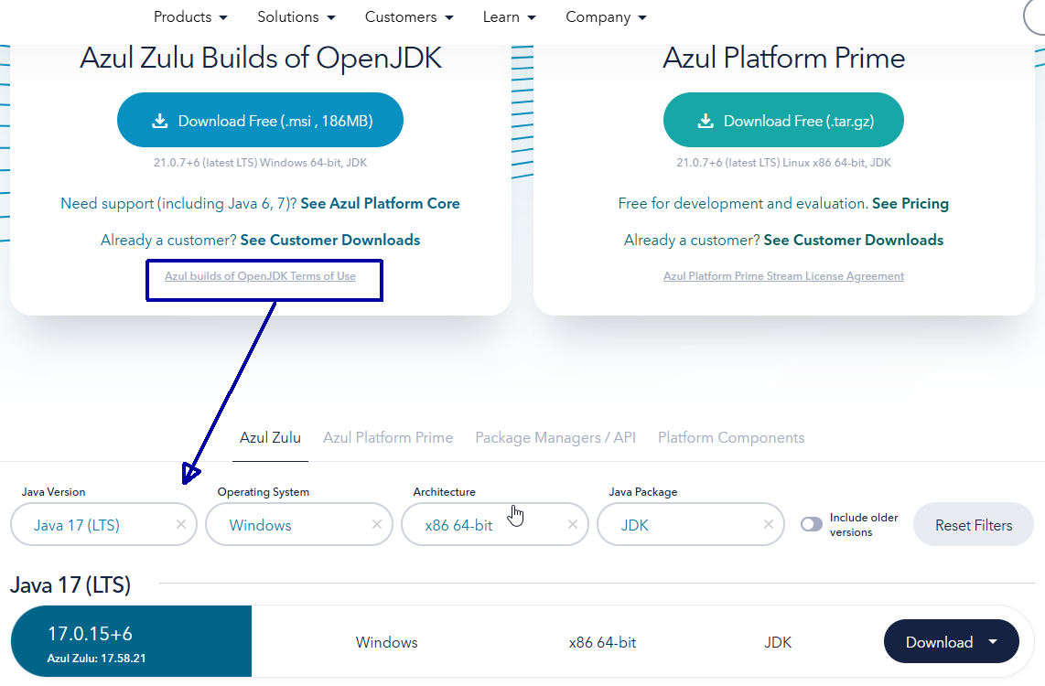
Downloading & Installing JAVA JDK

Slide 8
Installing JMRI
The JMRI web site has several options for installing JMRI.
https://www.jmri.org/releasenotes/jmri5.10.shtml
Actually, all current and past versions are available, but you want the current version.
Download links:
OS X / macOS: https://github.com/JMRI/JMRI/releases/download/v5.10/JMRI.5.10+Rca461bd266.dmg
sha256: 97e8d9d07c0e8e088a293349136102e337429a3f9542f794bbdc7b078658901d
Windows: https://github.com/JMRI/JMRI/releases/download/v5.10/JMRI.5.10+Rca461bd266.exe
sha256: e43afc7282dd17f428a89f38986b13086254af37d6bbf8859f50cb53ffe78a7e
Linux: https://github.com/JMRI/JMRI/releases/download/v5.10/JMRI.5.10+Rca461bd266.tgz
sha256: 886f4f7033da5339ac9778fc366c99e29af1ac9446bc3527b257aa8e1b69f179

Slide 9

Installing JMRI app
Running the downloaded file, you can accept all the defaults by clicking finish on each pane.
I typically edit the JMRI main folder as shown here, C:\JMRI
This makes it easier to find data or roster files, bu that is personal preference.
The defaults place start icons on the desktop, create a railroad called My JMRI Railroad, and generally sets things up.
IF you update to a newer version, you are asked if you what to write over the older version and if you want to save the older data. (Say yes to each)
Notes:
There's a new storage method for event names. Previously, these were stored in the IdTag table, which might be confusing. Starting with this release, they're separately stored in an eventnames/eventNames.xml file within the user files location. Names that were previously stored in the IdTag table will be automatically migrated to this new method.
This is from the new JMRI V5.20 installed two days ago.

Slide 10
Computer interface
JMRI has two main interfaces, ProgrammerPro and PanelPro.
PanelPro is focused on automating layout functions.
PanelPro may have One or more Panels that show:
layout track diagram
Live control for
  Turnouts
  Signals
  Block Occupancy

Slide 11
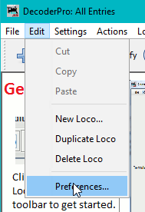
Profiles
JMRI is configured by profiles.
Profiles set up the look and feel of the screens, hardware connections, and anything you can configure as part of Decoder Pro or Panel Pro.
Note that decoder pro and panel pro use the same profiles, but use different parts.
No limit on how many profiles you have.

Slide 12
ProgrammerPro
By default, Decoderpro shows the roster and main menu when opening.
Along the bottom there are various status displays and options.
The following screen shots show how to set up Decoder Pro preferences

Slide 13
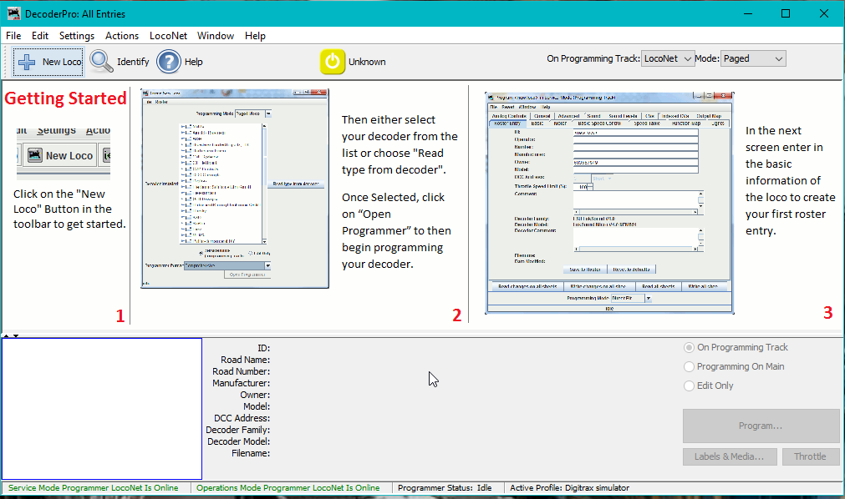
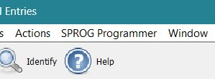
Start screen

Slide 14
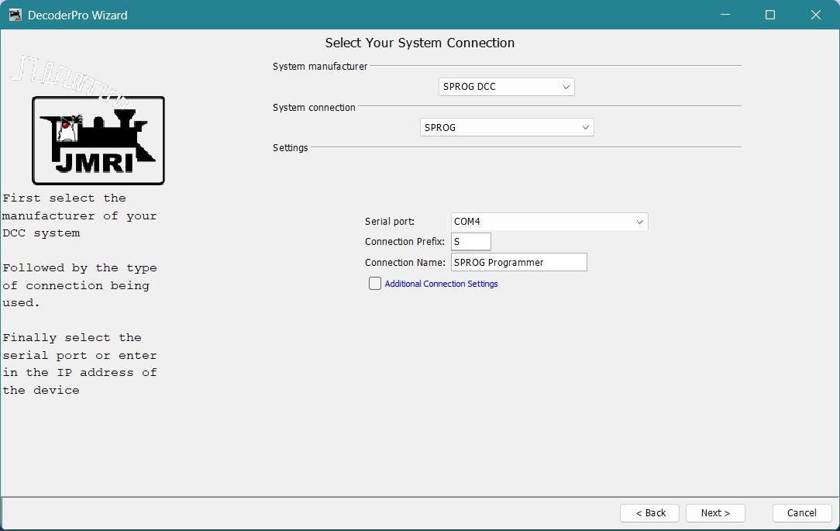
Select hardware connection

Slide 15
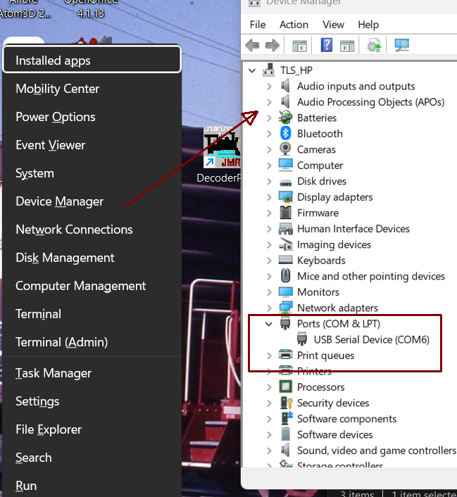
Which USB port?
If you do not know what port to use for connections, here is a quick way to find the correct port
Hold the window key, then press X
Select Device Manager
Expand the ports list.
You can plug the hardware USB cable in and out to see what changes.

Slide 16
WI-Throttle server
One of the more popular JMRI features is wireless throttles. Since this is open source, several manufacturers have produces compatible products on the market now.
Proto Throttle and Digitraxx LWNI come to mind.
Note that this is not yet an NMRA standard.
The following shows how to set up Wi throttle after you have JMRI installed.

Slide 17
What you need
Your JMRI PC and your throttle device (Smart phone, protothrottle, etc.) logged in to the same network. Home, club, etc.
For phones, Engine Driver for Android or WiThrottle for Apple. Several other app can also connect.

Slide 18
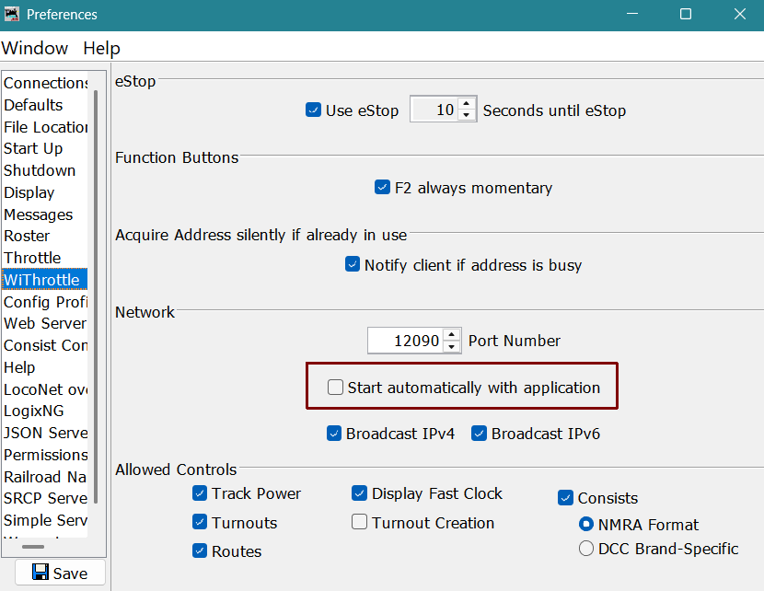
Wi Throttle settings

Slide 19
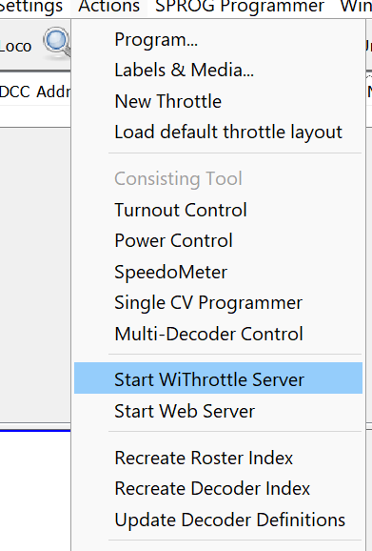
Start the server
Start the server from the actions menu.
(Or automatically on startup)

Slide 20
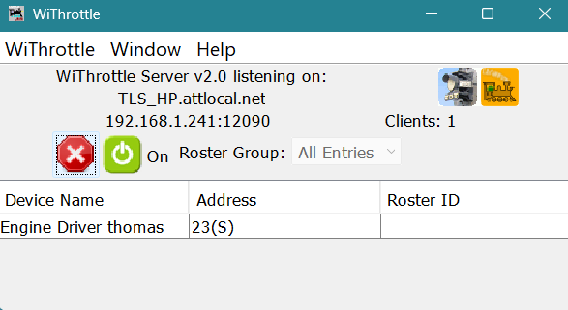
The server shows
who has connected
what address is in use
Connection information if the app did not find the server automatically
If you have roster entries, you can select fro the roster list in the app to get icons, function labels, etc.

Slide 21
Programming a decoder (engine)
The following slides will show how to read and program a decoder.
Note that there are two methods for programming, Program on the main (POM) and programming track (Service mode)
I will be demonstrating using a SPROG, which connects to a section of track not on a layout.

Slide 22
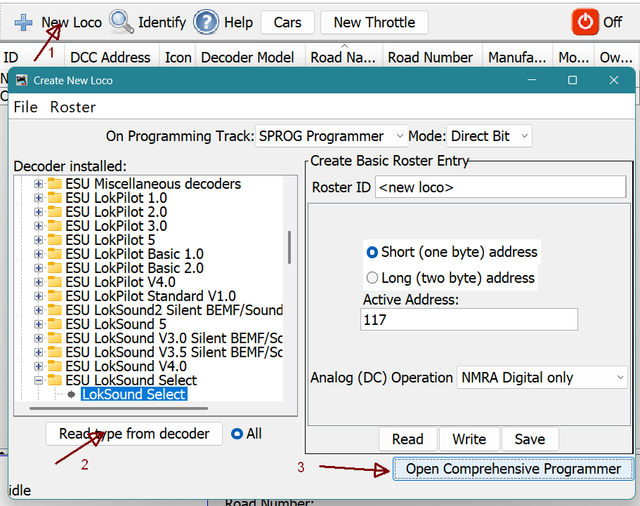

Slide 23
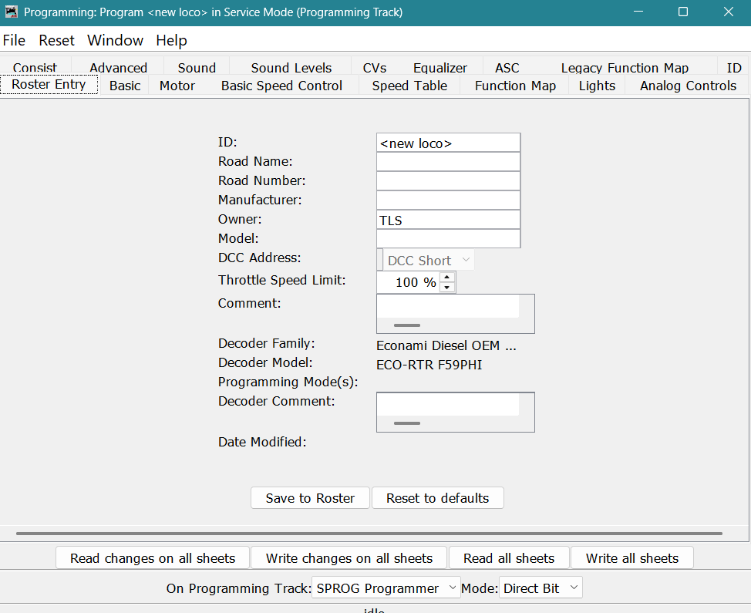
Notes:
Roster entry is how this record is saved in JMRI on your computer
Basic and CV panes are commont to most decoder definitions.

Slide 24
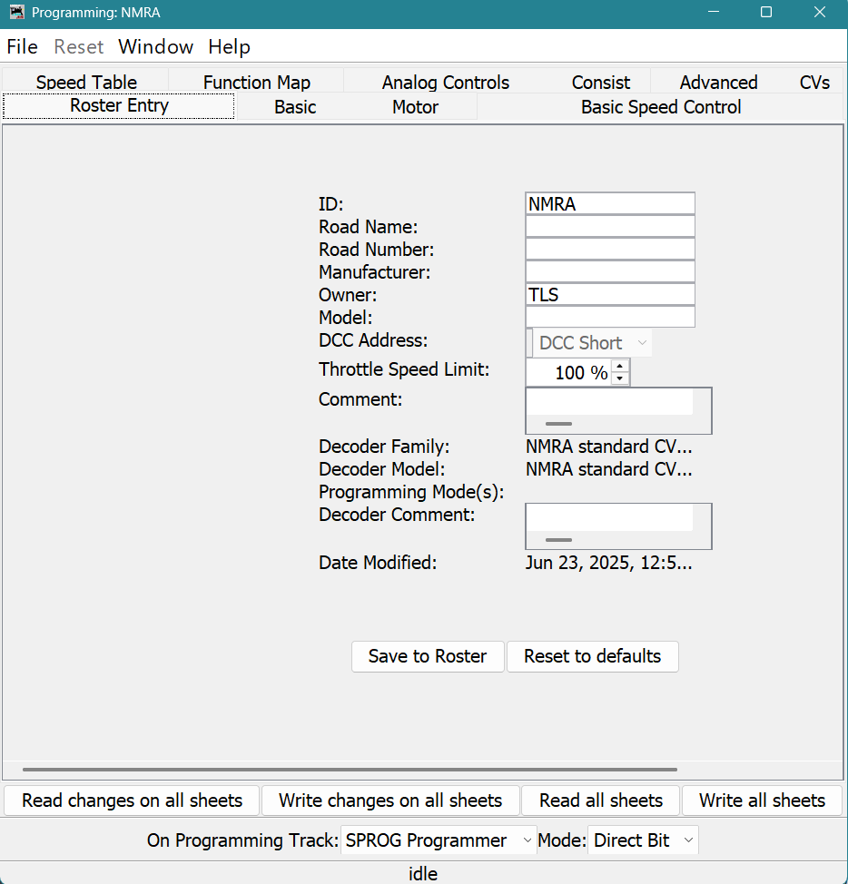

Slide 25


Slide 26
Questions?
If we have time, I can demonstrate some programming and other features.

